Slide 1
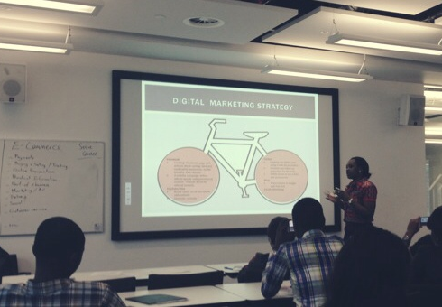
Digital Literacy
And its importance on Society and Tradition.
Presented by : Mr. Riwaj Dahal and the Team.

Slide 2

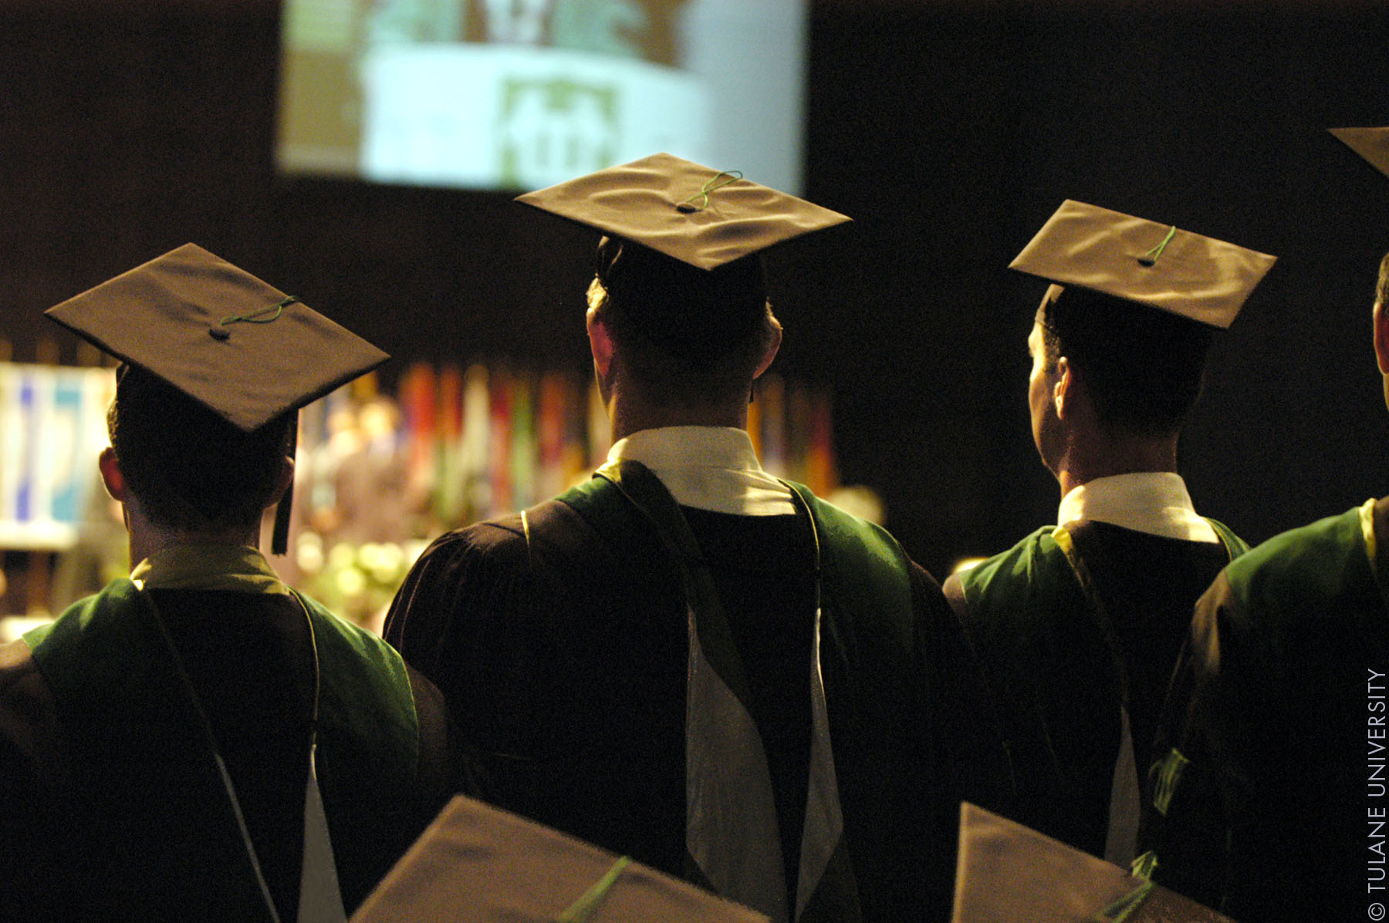
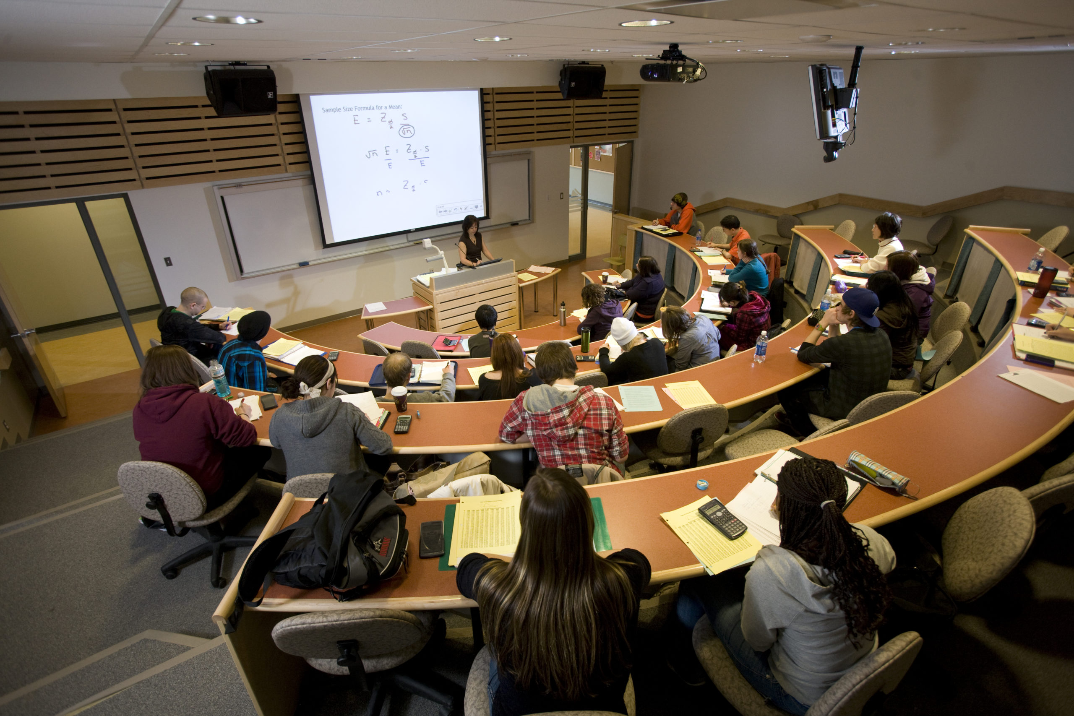
Topics covered:
Introduction to Literacy.
Introduction to Digital Literacy.
Its importance on Society and Tradition.
Discussion and Conclusion.

Slide 3
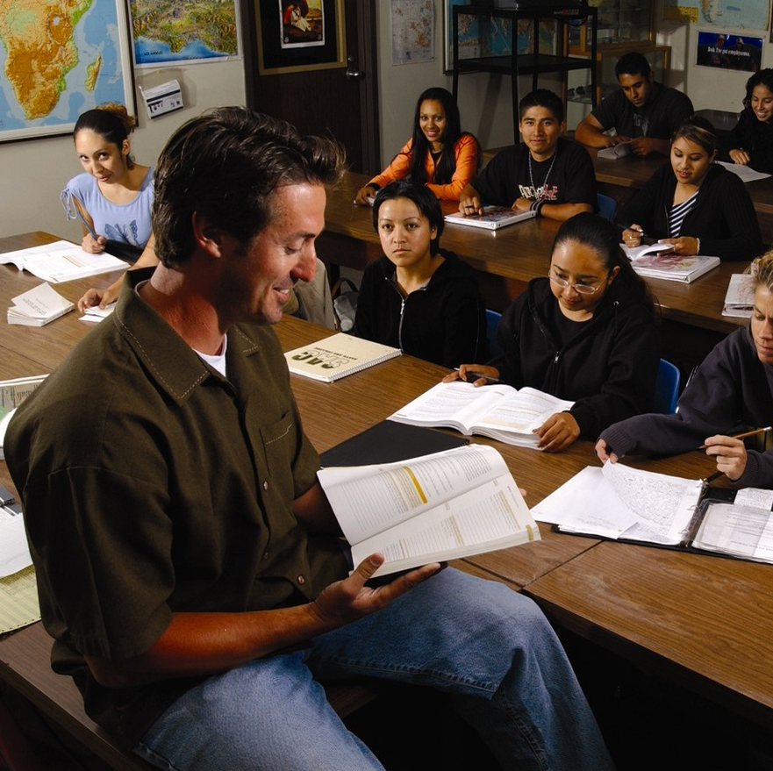
1. Introduction to Literacy.
Literacy is an essential life skill. It is the ability to read and write, and it is a fundamental part of our lives. It is so important because it gives us access to knowledge and allows us to communicate our ideas.
Being literate means having the ability to interpret and understand text, as well as the ability to express oneself in written form. There are several different types of literacy - from basic literacy to digital literacy - each with its own benefits. With the right knowledge and understanding, we can use literacy to our advantage and unlock new opportunities.

Slide 4
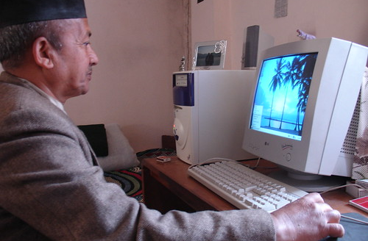
2. Introduction to Digital Literacy.
Digital literacy is an essential skill for success in the 21st century. It encompasses the ability to use technology for communication, collaboration, problem solving, and creative expression.
It also involves understanding how to use technology responsibly and ethically, including knowing how to evaluate and cite sources, protect personal information, and recognize and resist digital manipulation.
As technology continues to shape how we work and live, it is becoming even more important for individuals to develop their digital literacy skills. With a strong foundation of digital literacy, people can work confidently with technology to create a more connected and equitable world.

Slide 5
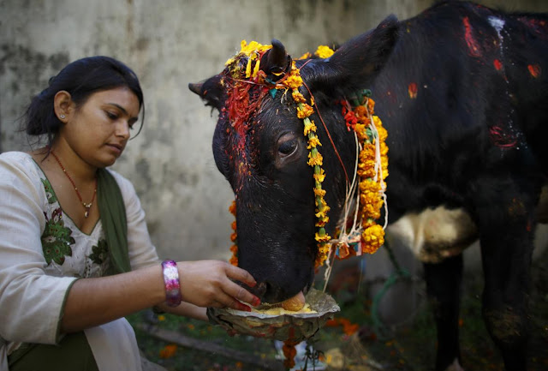
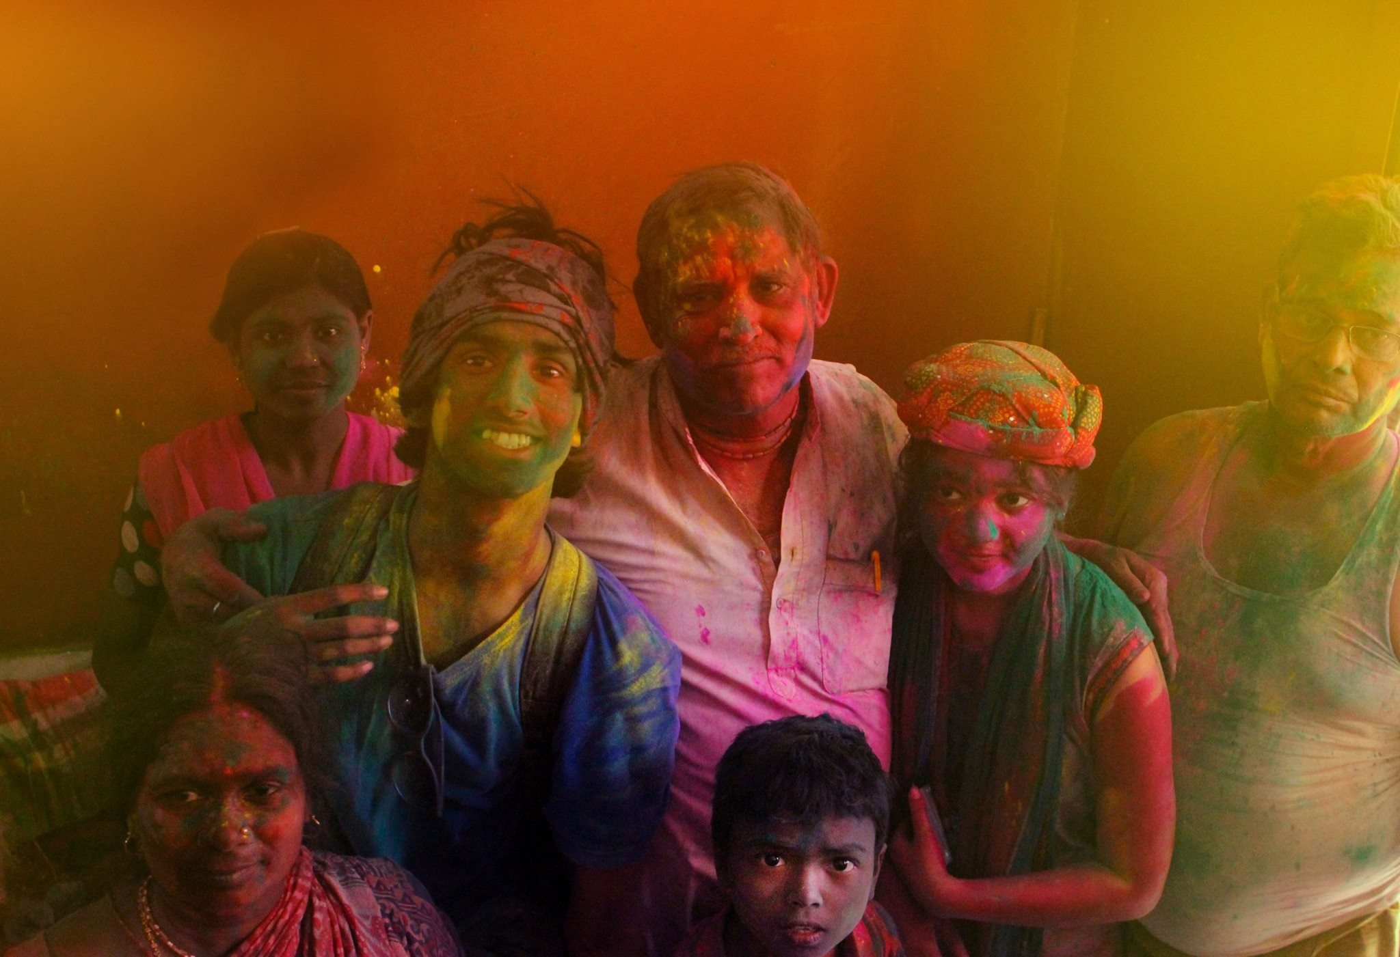
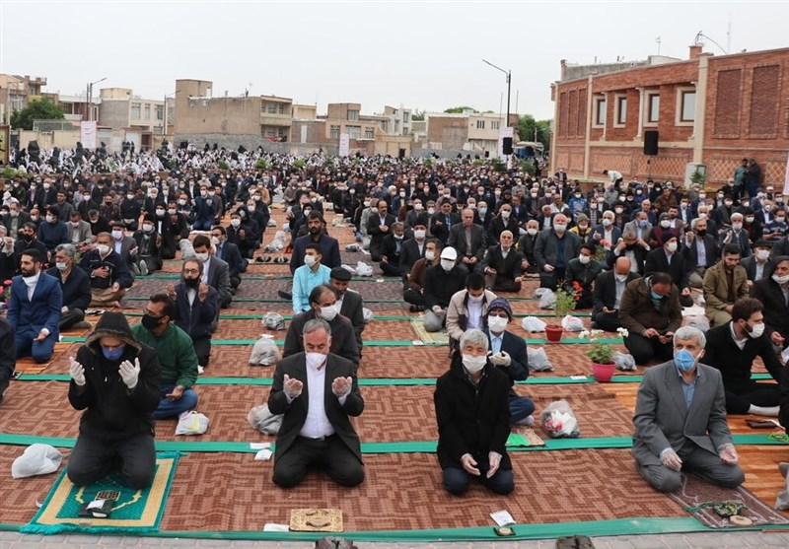
3. Its importance in Society and Tradition.
it also allows us to preserve the culture and traditions of our own communities.
we can record our stories and experiences and share them with the world.
We can document our culture, our beliefs, and our values, and pass them down from generation to generation.
- It gives us the opportunity to extend traditional and contemporary practices, and to create a better future.

Slide 6

4. Conclusion:
As technology keeps advancing in this modern world, we must try and keep up with it by being Digitally Literate.
It is a must to be literate about these technologies and our survival depends on it, so we must learn to use modern technology. Hence, here are some of the methods to improve our skill with modern technologies :
Taking Digital Literacy courses.
Taking online tutorials.
Reading latest books and magazines.
Joining online communities.
Keeping a mentor or asking help from collegues.

Slide 7

Thank You !!! For being with us throughout the Presentation. <3
Presented by:
Mr. Riwaj Dahal and the Team

